Slide 2
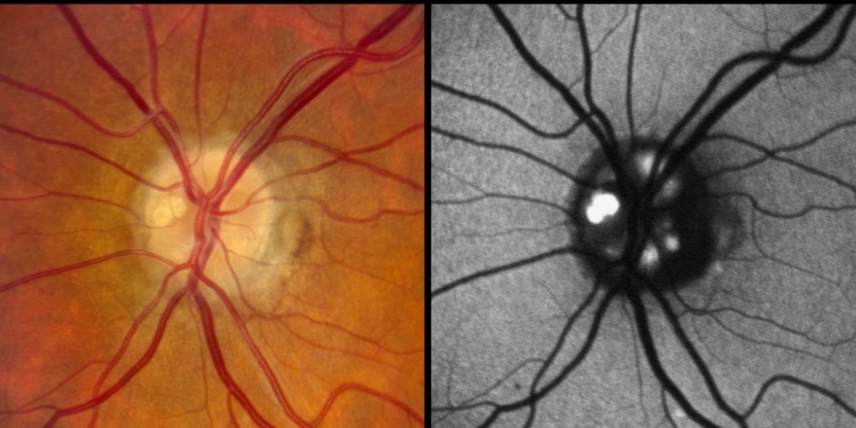
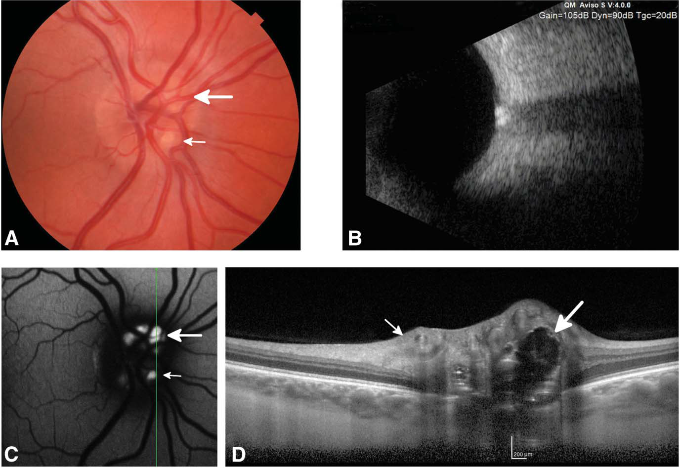
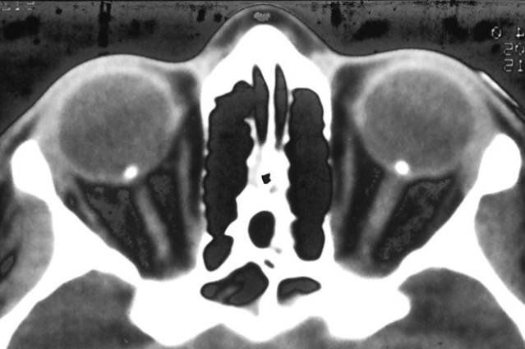
Studies for Drusen
Autofluorescence Photography
B-scan ultrasound
Computed Tomography
Optical Coherence Tomography

